Slide 1
Data Science with Deep Learning
DS101-2025-05
From dataset understanding to result presentation and how to employ deep acyclic graph models in Predictive Analytics
Lec. Andrei Ionut DAMIAN
As. Vitalii TODERIAN

Slide 2
Operational stuff
Repo/GitHub: ? (resources, etc)
Mandatory papers: clear ?
Optional papers: ideas ?
Assigned projects: home vs given?

Slide 3
Framing the problem in Data Science
No matter what problem you have
Ask the right questions!
Understand the intuition
Can a human with almost infinite time solve it?

Slide 4
Framing the problem: Customer Churn
How do you define churn?
Examples:
Customers that will discontinue purchasing/services after date
Customers that will decrease their rate of purchase/usage

Slide 5
Framing the problem: Customer Churn
Case #1: fixed period Churn definition.
How do we frame it?
Plan to construct features based on previous analysis (RFM, etc)
Extract as much information from data – patterns!
Apply classification model able to understand non-linear patterns
Remember we have structured data
Data is strongly skewed

Slide 6
Framing the problem: Customer Churn
Case #1: fixed period Churn definition.
Multiple solutions:
First try baseline decision trees (?) and logistic regression (?)
Apply Random Forests and better SotA XGBoost

Slide 7
Framing the problem: Customer Churn
Question: Mr. Hinton, what is something you wish you knew when you were younger?
Geoffrey Hinton: In 1986 I wish I knew this stuff was going to work! There were so many people who said it was nonsense. I wish I could have told them “you wait”, but that would have been a stupid thing to say, because it seemed impossible. What I wish I knew now, is whether the brain uses back propagation!

Slide 8
Framing the problem: Customer Churn
Case #1: “fixed period” Churn definition.
Multiple solutions:
First try baseline decision trees (?) and logistic regression (?)
Apply Random Forests and better SotA XGBoost
Finally we can search for a good DAG

Slide 9
Framing the problem: Customer Churn
Case #1: fixe period Churn definition.
Multiple solutions:
First try baseline decision trees (?) and logistic regression (?)
Apply Random Forests and better SotA XGBoost
Finally we can search for a good DAG
Last but not least: hyperparameter search – raw or intelligent

Slide 10
Framing the problem: Customer Churn
Case #1: fixe period Churn definition.
Multiple solutions:
First try baseline decision trees (?) and logistic regression (?)
Apply Random Forests and better SotA XGBoost
Finally we can search for a good DAG
Last but not least: hyperparameter search – raw or intelligent
Wrap-up: compare, benchmark, choose

Slide 11
Finding a good DAG
Grid-search or “smart”-search

Slide 12
Hyperparameter search
How many layers?
What size each layer?
How many skip connections and where exactly?
What activation functions?
What output?
Dropout and/or weights penalty (L1?, L2?) ?
BatchNorm? Where?
Optimization algoritm?
Learning rate?

Slide 13
Complexity!
Let’s see…
We decided to give a look at 9 hyper-params..
How about 5 options (minimal) for each…
About 2M possibilities!
This each test needs at least 10 epochs
So we have about 20M epochs
…maybe millions of hours

Slide 14
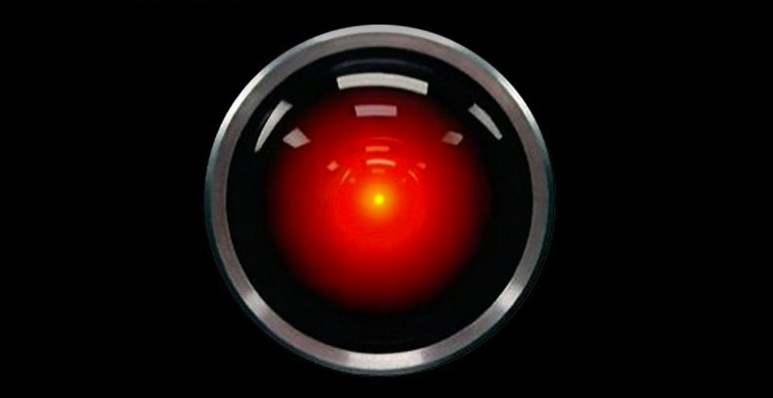
202+: A search space odyssey

Slide 15
Hyperparameter search
Importance
Focus on most relevant hyperparameters
Make mental and written lists
Order them depending of your problem/setting

Slide 16
Hyperparameter search
Example: Is regularization important? Dropout, weight penalty?

Slide 17
Hyperparameter search
Importance
Creativity

Slide 18

Neural Network design is a bit of art
…No, this is not NN design, it is just some CNN-based generative stuff (Deep Dream)

Slide 19
Hyperparameter search
Importance
Creativity
Resources:
Is compute time limited -> then run random search
Do we have resource limitation -> choose careful designs

Slide 20
Hyperparameter search
Importance
Creativity
Resources
“Good-enough” point?
Do we need that increase from 95.87% recall to 95.91% ?
What the “customer” needs is what matters!

Slide 21
Simple Hyperparams search
Start simple with preparing the grid
See if the grid is large, if not just run it!
If it is large then run “some” random sample of it
No matter how full or partial analyze your best results
Now you can narrow even more your search
Better yet an example

Slide 22
Simple Hyperparams search
Simple (naïve) experiment setup:
Param1: Learning Rate from 1e-6 up to 0.5
Param2: Number of layers from 2 to 20
We search P1: {1e-6, 1e-5, 1e…} P2: {2, 5, 10, 20}
We find a point of validation optimum say P1: 1e-4, P2: 10
We narrow the search left/right and we repeat
After multiple iterations we have either:
Optimal point (depending on validation dataset)
Bounce-back areas (more likely)
We can settle for good-enough

